Slide 1
SOEN 343
08 Structural design patterns

Slide 2
Learning objectives
Identify structural design patterns
Explain the difference between creational patterns
Evaluate in which situations is appropriate to apply the adapter pattern
Explain the difference between an object adapter and a class adapter
Evaluate in which situations is appropriate to apply the decorator pattern

Slide 3
Design patterns classified by their intent
Creational patterns
Structural patterns
Behavioral patterns

Slide 4

Structural patterns

Slide 5
Structural patterns
Composite. Compose objects into tree structures, treating al nodes uniformly
Adapter: Convert interface to improve interoperability
Bridge: decouple abstraction and implementation; abstract class contains member that is its implementation
Decorator: attach additional responsibility to an object dynamically
Façade: provide a unified interface to a subsystem
Proxy: provide a surrogate for another object to control access
Flyweight: using sharing to support a large number of fine-grained objects efficiently

Slide 6

Adapter pattern: motivation and intent
Motivation
Like any adapter in the real world it is used to be a bridge between two objects that have the same functionality, but that are to be used in a different manner, i.e. have a different specification to their interfaces. In the real world we have adapters for power supplies, for memory cards, for video cables, and so on.
The same concept applies to software components. You may have some class expecting some type of object and you have an object offering the same features but exposing a different interface. You don't want to change existing classes, so you want to create an adapter.
Intent
Convert the interface of a class into another interface that clients expect
The adapter lets classes work together, that could not otherwise because of incompatible interfaces

Slide 7
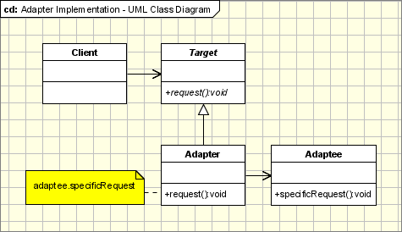
Classes and their roles
The classes/objects participating in adapter pattern:
Target - defines the domain-specific interface that Client uses
Adapter - adapts the interface Adaptee to the Target interface
Adaptee - defines an existing interface that needs adapting
Client - collaborates with objects conforming to the Target interface

Slide 8
Adapter pattern: context
The adapter pattern is used when:
You have a client class that invokes methods defined in a certain class or interface (Target) and you have another class (Adaptee) that doesn't implement the same interface as the Target, but still implements a similar service
You can change none of the existing code (nor Target or Adaptee can be changed).
You need an adapter to implement the interface that will be the bridge between the client class and the Adaptee

Slide 9
Adapter pattern example
If it walks like a duck and quacks like a duck, then it must might be a duck turkey wrapped with a duck adapter...
Now it’s time to meet the newest fowl on the block:
public interface Duck {
public void quack();
public void fly();
}
public interface Turkey {
public void gobble();
public void fly();
}
public class MallardDuck implements Duck {
public void quack() {
System.out.println("Quack");
}
public void fly() {
System.out.println("I'm flying");
}
}
public class WildTurkey implements Turkey {
public void gobble() {
System.out.println("Gobble gobble");
}
public void fly() {
System.out.println("I'm flying a short distance");
}
}

Slide 10
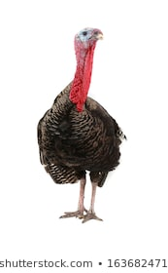
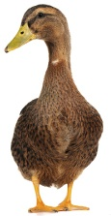
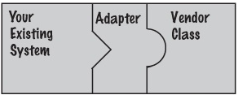
Now, let’s say you’re short on Duck objects and you’d like to use some Turkey objects in their place
Obviously, we can’t use the turkeys outright because they have a different interface
Let’s write an Adapter:

Slide 11
Code example: adapter
public class TurkeyAdapter implements Duck {
Turkey turkey;
public TurkeyAdapter(Turkey turkey) {
this.turkey = turkey;
}
public void quack() {
turkey.gobble();
}
public void fly() {
for(int i=0; i < 5; i++) {
turkey.fly();
}
}
}

Slide 12
Code example: driver class
public class DuckTestDrive {
public static void main(String[] args) {
MallardDuck duck = new MallardDuck();
WildTurkey turkey = new WildTurkey();
Duck turkeyAdapter = new TurkeyAdapter(turkey);
System.out.println("The Turkey says...");
turkey.gobble();
turkey.fly();
System.out.println("\nThe Duck says...");
testDuck(duck);
System.out.println("\nThe TurkeyAdapter says...");
testDuck(turkeyAdapter);
}
static void testDuck(Duck duck) {
duck.quack();
duck.fly();
}
}

Slide 13
Object vs class adapters
Class Adapters use multiple inheritance to achieve their goals.
As in the classic adapter (often called an “object adapter”), the class adapter inherits the client's Target class. However, it inherits the Adaptee as well.
Since Java does not support true multiple inheritance, this means that one of the classes must be a Java interface type
Both of the Target and Adaptee interfaces could be Java interfaces, but only one needs to be an interface.
The request to the Target is simply rerouted to the specific request that was inherited from the Adaptee interface.
Notes:
Object Adapter uses composition
Class adapter uses inheritance

Slide 14
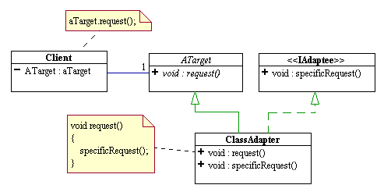
Class adapter design
The adapter lets the Turkey respond to requests on a Duck by extending Both classes

Slide 15

Decorator pattern: motivation and intent
Motivation:
Sometimes we may want to dynamically add some data members or methods to an object at runtime, depending on the situation
Intent:
Allow to add new functionality to an existing object without altering its structure.
Create a Decorator class that wraps the original class.
Provides additional functionality while keeping the class’ methods’ signatures intact.

Slide 16
Decorator design

Slide 17
Elements of the Decorator pattern:
Component - Abstract class representing the objects to be decorated by the various Decorators
Concrete Component - The potentially many sub-classes that can be decorated
Decorator - Abstract class that wraps a Component and will have some of its subclasses to decorate it
Concrete Decorator - Different decorators that add different members to the Component and use these members to provide additional behavior to the decorated object

Slide 18
Decorator pattern example: Coffee shop

Slide 19

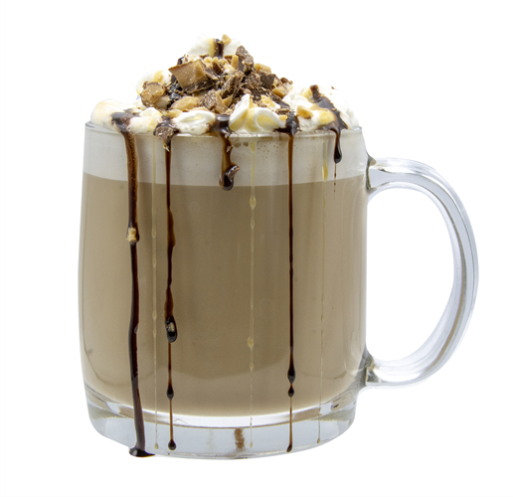
Problem
In addition to your coffee, you can also ask for several condiments like steamed milk, soy, and mocha, and have it all topped off with whipped milk
The coffee shop charges a bit for each of these, so they really need to get them built into their order system

Slide 20
Applying decorator pattern to coffee shop
component
concrete components
decorator
concrete decorators

Slide 21
code example: component & concrete comp.
public abstract class Beverage {
String description = "Unknown Beverage";
public String getDescription() {
return description;
}
public abstract double cost();
}
public class DarkRoast extends Beverage {
public DarkRoast() {
description = "Dark Roast Coffee";
}
public double cost() {
return .99;
}
}

Slide 22
Code example: decorator & concrete deco.
public abstract class CondimentDecorator extends Beverage {
Beverage beverage;
public abstract String getDescription();
}
public class Mocha extends CondimentDecorator {
public Mocha(Beverage beverage) {
this.beverage = beverage;
}
public String getDescription() {
return beverage.getDescription() + ", Mocha";
}
public double cost() {
return .20 + beverage.cost();
}
}

Slide 23
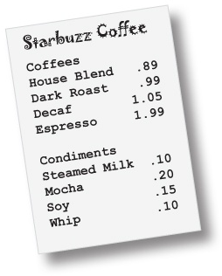
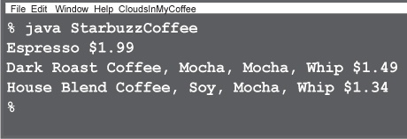
code example: driver class
public class StarbuzzCoffee {
public static void main(String args[]) {
Beverage beverage = new Espresso();
System.out.println(beverage.getDescription()
+ " $" + beverage.cost());
Beverage beverage2 = new DarkRoast();
beverage2 = new Mocha(beverage2);
beverage2 = new Mocha(beverage2);
beverage2 = new Whip(beverage2);
System.out.println(beverage2.getDescription()
+ " $" + beverage2.cost());
Beverage beverage3 = new HouseBlend();
beverage3 = new Soy(beverage3);
beverage3 = new Mocha(beverage3);
beverage3 = new Whip(beverage3);
System.out.println(beverage3.getDescription()
+ " $" + beverage3.cost());
}
}
Expresso
dark roast Double mocha with whip
house blend soy, mocha and whip

Slide 24
References
Erich Gamma, Richard Helm, Ralph Johnson and John Vlissides, Design Patterns – Elements of Reusable Object-Oriented Software, Adisson-Wesley, 1995.
SourceMaking.com. Design Patterns.
Freeman, Eric, et al. Headfirst design patterns. O'Reilly, 2004

